Slide 1

Software Project Management
In the name of Allah, the Beneficent, the Merciful
Lecture 13
Human Resource Management

Slide 2
Determining Project Needs
Who do you need?
How will you answer this?

Slide 3
Determining Project Needs
Who do you need?
What is the best way to determine what to do?

Slide 4
Determining Project Needs
Work Breakdown Structure (WBS)

Slide 5
Determining Project Needs
Work Breakdown Structure (WBS)
Roles & Responsibilities Matrix

Slide 6
Roles & Responsibilities Matrix
Identify Major Deliverables Use Work Breakdown Structure (WBS)
Identify Roles Title, Department or Specialty
Identify Responsibilities RASCI (Responsible, Approves, Supervises, Consults, Informed)

Slide 7
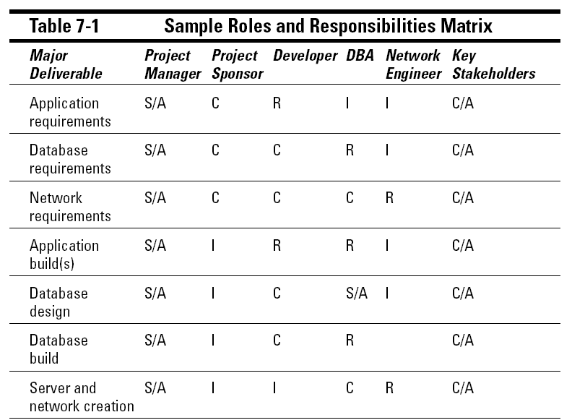
Roles & Responsibilities Matrix

Slide 8
Finding Team Members
Using (Resource Pool) Database
Using Historical Information
The collection of past project records
Ask other project managers in your organization to point you towards the talent you need
Ask Human Resources staff, functional managers, and your colleagues to point you to the talent you need on your project team

Slide 9
Project Manager’s Role
Manager Manages project team to get the project successfully completed
Leader Motivates, align and direct project team

Slide 10
Finding Team Members
Asking Questions that Facilitate Resource Management
Asking Questions that Facilitate Leadership Potential
Finding a STAR

Slide 11
Questions That Facilitate Resource Management
What other projects are you working on?
What time commitments do you have on these projects?
What areas of this project excites you the most?
What areas of this project do you dread?
What areas of this project have done before?
Have you ever worked with technology such-and-such?

Slide 12
Questions That Facilitate Leadership Potential
What are your career goals?
Are there any areas within this project that can bring you closer to achieving your career goals?
What excites you about this project?
What would you like to learn from this project?
What opportunities do you see to make this project better?

Slide 13
Finding a STAR
STAR stands for Situation, Task, Action and Result.
STAR is an interview method, that gives you insight into a person’s experience, accomplishment and strengths.
You ask question that requires the prospective team member to discuss a specific situation or task he/she faced and what action he/she took to resolve the issue.
The belief behind this concept is that person’s past behavior is an indicator of his/her future actions.

Slide 14
Who Is Really in Charge
The level of power you have as a project manager is tied to the structure of your organization.
It’s more than just the power at the top of the flow chart, but rather who has the project power when it comes to making decisions for your project team.

Slide 15
Organizational Structures
Projectized Assigns the power to the project manager
Strong Matrix Assigns more power to the project manager than the functional (department) manager
Balanced Matrix Assigns equal power to the project manager and the functional manager
Weak Matrix Assigns more power to the functional manager than the project manager
Functional Assigns the power to the functional manager
Composite Intermingles parts of the other organizational structures

Slide 16
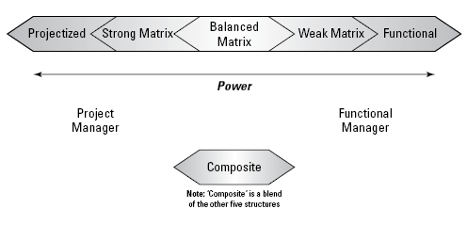
Organizational Structures
The level of power you have depends on which organizational structures your company adheres to.

Slide 17
Organizational Structures
“Pros & Cons” of Functional Structure
Only the project manager, and the functional manager need to communicate with each other
There is no confusion about who’s in charge.
Technical decisions may be made by someone with little (or no) technical experience
The project manager has no power to make project decisions but holds the blame if the project fails.

Slide 18
Organizational Structures
“Pros” of Matrix Structures
Resources can be used from all over the organization.
The project manager may work as project manager on a full-time basis.
Project team members are not on the project full-time, but only when their discipline is needed.

Slide 19
Organizational Structures
“Cons” of Matrix Structures
Power struggles
The project team is often confused about who’s in charge
With multiple functional managers, the PM faces huge communications demands
The project team members are probably on multiple projects with different project managers

Slide 20
Organizational Structures
“Pros & Cons” of Projectized Structure
The project team contributes to projects full-time.
Communication demands are greatly reduced.
The project manager has autonomy over project decisions.
Usually a project office or program office will support the project manager.
The downside of a projectized organization is that the project team may have anxiety when the project wraps up.

Slide 21
Summary
Using Work Breakdown Structure
Creating Roles & Responsibility Matrix (RASCI)
Project Manager’s Roles: Manager vs Leader
Finding Team Members
Understanding Project Authority / Organizational Structures
Using First Project Meeting

Slide 22
Plan “Project” HR Management
Who has authority over the project team
How team members are brought into and released from the project team
The process for team members discipline
The expectations for the roles within the project team
Rules and Policies
NOTE: HR Plan must be approved by Organization’s HR Department

Slide 23
Software Project Management
Process Groups
Knowledge Areas
Initiating
Planning
Executing
Controlling
Closing
Scope Management
Time Management
Cost Management
Quality Management
Human Resources Management
Communications Management
Risk Management
Procurement Management
Integration Management
Stakeholder Management

Slide 24
Q & A

